Slide 1
Jagdeep Passan – CEO Leeds Involving People
Sharing Good Practice – Governor Regional Workshop, Leeds
4th April 2019

Slide 2
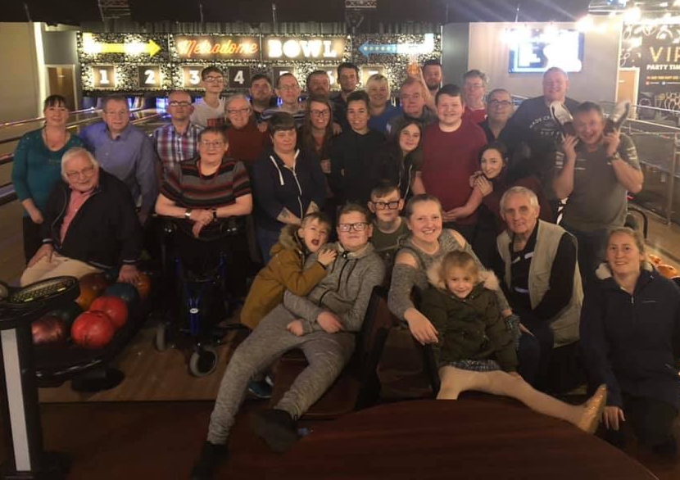
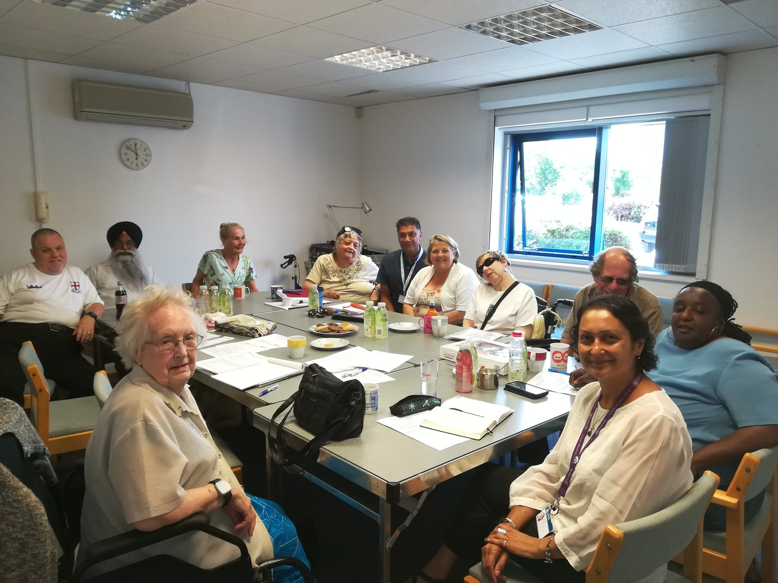
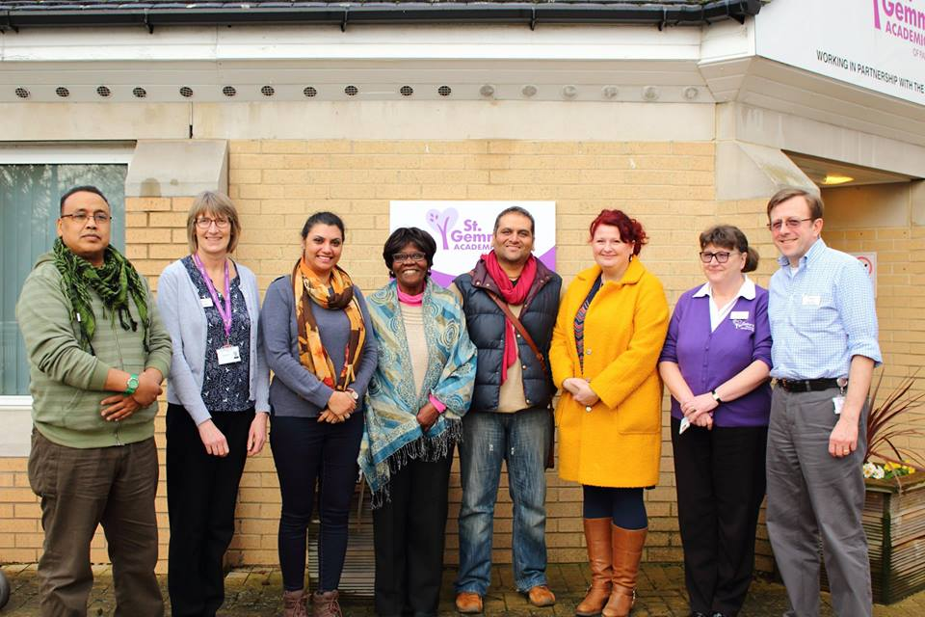
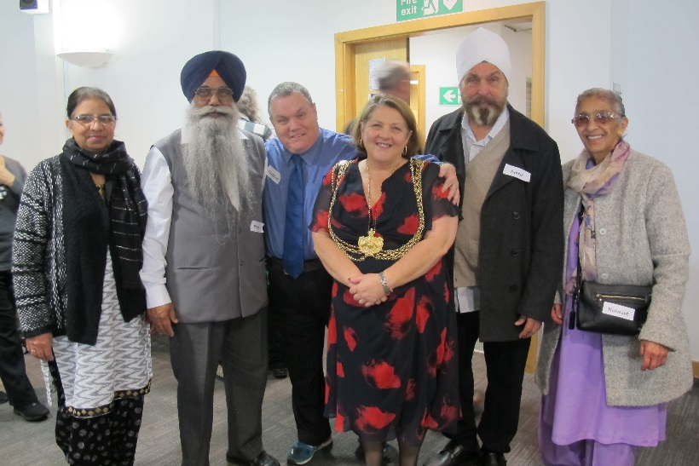
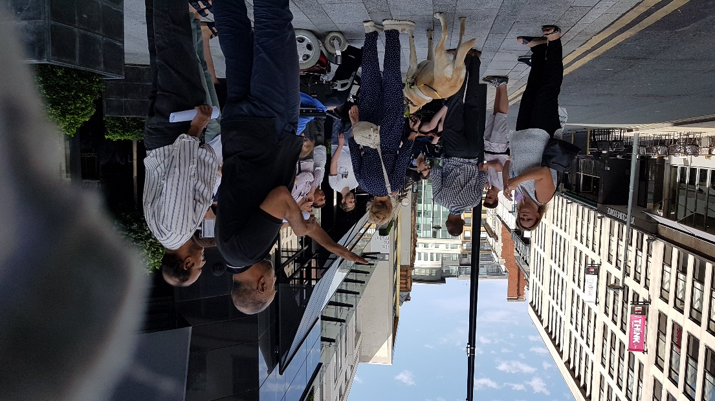
Sharing Good Practice – Engaging with the Public by Leeds Involving People
Barnsley Deaf Community
Connecting Leeds
LIP Board
St Gemma’s Group
LIP AGM
Access Group (AUAG)

Slide 3
Who are Leeds Involving People?
LIP’s Mission Statement: Leeds Involving People link decision-makers and communities. We give a voice to residents and support the improvement of health, social care and community services.
Leeds Involving People (LIP) have connected lived experience with service improvement since 1995.
LIP is a user-led organisation, independent of service provision (LIP USP). We have over 400 members across different forums.
LIP’s Vision is to enable stronger communities that influence the services they use.
“When asked by us, ASC, for a quick response to a piece of consultation LIP are able to get a group of people together in a matter of days at short notice which cannot be done by anyone else.” – Adults and Health

Slide 4
Introduction – NHS Involvement
“All of us – patients, providers and regulators – want an NHS that prolongs and enhances life, which promotes recovery, treats people in a safe environment and ensures people have a positive experience of collaborative care. Despite our shared aspirations, we are rarely the sum of our parts. Fear of change, creaking dysfunctional governance structures, limited ambition and fighting the fire of business as usual are familiar barriers to unlocking the potential of true collaboration.” – Jagdeep Passan, NHS Confederation Blog
Section 3a of the NHS Constitution sets out the minimum rights of patients as follows:
“You have the right to be involved, directly or through representatives, in the planning of healthcare services commissioned by NHS bodies, the development and consideration of proposals for changes in the way those services are provided, and in decisions to be made affecting the operation of those services.”
A look at the Handbook to the NHS Constitution expands on this right:
“You have the right to have your say in person or through a representative:
in the planning of healthcare services commissioned by the NHS England and clinical commissioning groups
on the proposals for any changes in the way in which those services are provided; and
on decisions which may affect the operation of those services.
This right applies if implementation of a proposal or decision would have an impact on:
the manner in which services are delivered to you or other people; or
the range of health services available to you or other people.”

Slide 5
Member Roles in the NHS-FT
Ensure public are involved and provide challenge
Quality services that reflect the needs of an ageing population and the demographic areas are delivered
Work in partnership with their PPI teams and boards
New directives around shared care, population needs and understanding the communities we work in – do we know our populations? Does investment flow into community work? Are we innovative enough? Or are we traditional?

Slide 7
Access and Use-Ability Group – LCC Independent Chair
The AUAG was developed when the John Lewis Partnership contacted the leader of Leeds City Council requesting stakeholder involvement in the new Victoria Gate Development.
This group sits under Leeds City Council’s Communities directorate and has robust support from the staff team and leadership from the Director of Communities, with the chair of this group being an independent chair.
From this the AUAG progressed into the key stakeholder engagement group for Leeds City Council to ensure people are involved in Highways and Planning decisions. This is a partnership group made up of staff, citizens and various invited guest speakers to ensure Leeds is a truly inclusive city and being the best city to live in.

Slide 8
Access and Use-Ability Group – Impacts Independent Chair
Public involvement in the pedestrianisation of Greek Street
Expert advice in the development of Leeds City Bus Station, with First Buses
Analysis of the Headrow and City gateways developments
Involvement with West Yorkshire Playhouse
Packed agendas for the third year running

Slide 9
Connecting Leeds – Transport, WSP and LCC
Connecting Leeds is the ambition to transform travel in Leeds for people who live, work in and visit the city.
In 2016, Leeds City Council started their biggest-ever transport conversation in which over 8,000 people told them what’s important to them and for Leeds. In response to this they worked with the West Yorkshire Combined Authority and other partners to produce the Leeds Transport Strategy.
LIP have led on public engagement for this project.
A core team of 5 outreach staff from LIP have visited businesses and organisations across the routes impacted by the proposals and contacted a wide network of key stakeholders by phone, email and social media; these included residents’ groups, community interest groups, third sector organisations and LIP’s extensive membership network.
Arrangements were also made to visit schools, community organisations, libraries, leisure centres and retail outlets to promote the consultation.
“Leeds Involving People (LIP) are a key partner in ensuring that seldom heard groups are involved in shaping a transport strategy for Leeds that’s inclusive and meets the needs of individuals, communities and the city” - Report of Director of City Development, 25th July 2018

Slide 10
Connecting Leeds – Impacts
Online activity spiked when LIP’s workers were out
Hailed as best practice nationally
LIP’s CEO and Chair sit on the Leeds Transport Expert Advisory Panel
Less public outcry to the local authority because LIP is trusted
“Leeds Involving People (LIP) are a key partner in ensuring that seldom heard groups are involved in shaping a transport strategy for Leeds that’s inclusive and meets the needs of individuals, communities and the city” - Report of Director of City Development, 25th July 2018

Slide 11
Together We Can – Leeds NHS CCG
Together We Can is a Leeds, citywide involvement network for people with lived experience of using, or supporting/caring for someone who uses or has used mental health support services in Leeds.
TWC is now an experienced and effective user-led group, committed to the principles of co-production. We have a clear understanding of how the involvement and engagement of people who use mental health services is crucial to ensuring the most effective partnership towards improving and designing services.
There is a core steering group that meets every month sharing experience and information across the wider mental health networks.
Individual members receive support and training from Leeds Involving Peoples’ Senior Involvement and Development Worker to equip them to take part in all aspects of the CCG’s work streams.
TWC members are influential across the widest spectrum of mental health commissioning and provider networks in Leeds and West Yorkshire, including Adult Social Care, Third Sector, LYPFT, local Universities and research networks.

Slide 12
I Statements
Leeds NHS CCG requested a series of I Statements from those with lived experience of mental ill health.
I Statements have become the overarching principles informing the design and vision of mental health services in Leeds. They have been written into mental health service contracts from April 2017. These statements were co-produced as a collaboration with our members.
I am more than a mental health diagnosis. Treat me like an individual human being.
I may rely on family and friends to stay well. Give them support, information and respect.
I want to be heard and included, regardless of my identity. Offer me accessible and culturally competent support.
I may be facing more than just a mental health challenge (e.g. Substance abuse including alcohol or a physical condition). Respond creatively, and without judgement.
I will know the name of the person responsible for my support. Show me that you are a human being too.
I have a story to tell. Share information effectively, with my permission, so I don’t have to repeat myself.

Slide 13
Better Lives Board – Adults and Health LCC
The Better Lives Board has been created by Leeds Adults and Health, a directorate of Leeds City Council, to ensure people are at the centre of the decision-making process as part of the Better Lives strategy.
LIP ensure service users are involved with this strategy by ensuring that there are opportunities to feedback.
This is co-chaired by a Councillor and a LIP member. They discuss a range of issues relevant to social care.
Impacts:
Equality strategy review
Homeshare
Day services modernisation
Extra care homes investment

Slide 14
Adults and Health LCC Projects
Social Care Community Forum for Race Equality (SCCFRE) – the purpose of the SCCFRE is to bring together members of the BAME communities in Leeds. This feeds into the Better Lives Board and various networks in the community. The members have been instrumental in guiding the Local Authority and partners in areas like Windrush, the BME Your Health, Your Say Conference, prescription medicine management for NHS England, BME Day Services Redesign, Healthwatch Leeds, NHS CCGs. The members are seen as “Involvement Ready” and can provide a critical friend in Leeds.
The Equipment and Telecare Service User Group (TETSUG) – this group focuses on technology and equipment, issues with items supplied by Leeds Community Equipment Services and finding ways to resolve them, and giving feedback to technicians developing new technologies and products.

Slide 15
Visible Reference Group
Visible began as a partnership between Women’s Counselling and Therapy Services, funded by Lloyds Bank. LIP facilitate the reference group, working with people who have experienced child sexual abuse.
Leeds Visible project is about making the invisible visible, in order to improve health and wellbeing outcomes for adult survivors of child sexual abuse.
Visible is a catalyst for system change across Leeds, with adult survivors influential in all aspects of delivering improvements.
Visible:
Influences service providers at strategic, organisational and frontline levels
Impacts strategy, policy and commissioning
Equips staff with awareness and confidence to develop competence
Shares best practice and disseminates learning and national research.

Slide 16
Drug and Therapeutics Group
This group was Leeds Teaching Hospitals NHS Trust working in partnership with LIP to ensure people are involved with medicine management.
LIP worked with Head of Pharmacy for one year to develop a paper about the benefits and risks of service user involvement.
LIP were commissioned to do a small piece of work to involve two lay people in medicine management.
Impacts:
Embedded in-house
Significant contribution recognised

Slide 17
St Gemma’s Hospice Steering Group
This began as a joint project between LIP and St Gemma’s Hospice focusing on why people who are representative of BAME communities don’t access St Gemma’s Hospice’s services.
We investigated what BAME community members already knew about St Gemma’s Hospice and used this information to tailor the questions we asked while surveying. Over the course of the project we engaged with over 1000 BAME community members living in LS7 and LS8 by going into areas such as:
Door-to-door
GP Practices
Places of Worship
Community Venues
We also facilitated focus groups with specific communities within the BAME communities. We engaged with over 50 community members this way who were representative of various different religions.
Throughout this initial project we also recruited for an Involvement Group to work with St Gemma’s Hospice on:
Implementing the recommendations
Improving communication between St Gemma’s Hospice and local BAME community members

Slide 18
St Gemma’s Hospice Steering Group – Impacts
Over two years later the Involvement Group continues to be supported by LIP to meet with St Gemma’s staff and continue to improve the service offer of the hospice.
Last month, we also held a very successful event at St Gemma’s, in partnership with Yorkshire Bank, with around 40 community members to discuss how to increase the reach of St Gemma’s and their services.
People have impact on policy and practice working with the leadership team.

Slide 19
Considerations
Patient experience can only be better if patients are involved in decisions.
“No decision without me about me.”
The use of independent third sector organisations is important as they have the trust and can deliver on your behalf.
Do the staff have the expertise to deliver on community engagement e.g. at LIP our team is representative of the community?
How do you co-produce your redesign programmes with people at the centre?

Slide 20
Our Funders/Sponsors
We would like to thank our funders, partners and sponsors for all that they do.

Slide 21
Thank you for listening
Jagdeep Passan – CEO Leeds Involving People
Sharing Good Practice – Governor Regional Workshop, Leeds
4th April 2019

